Slide 1




Employee Attrition Analysis
Instructor: Prof. Khasha Dehnad
Course: CS 513 Knowledge Discovery and Data Mining
Meghana Bhat Manikal Akhil Manchikanti Rajat Verma Sanam Sritam Jena
Course Section: A Course Section: A Course Section: A Course Section: B
Department: CS Department: CS Department: CS Department: CS
Level: Graduate Level: Graduate Level: Graduate Level: Graduate

Slide 2
Introduction
Staff attrition refers to the loss of employees through a natural process, such as retirement, resignation, elimination of a position, personal health, or other similar reasons. With attrition, an employer will not fill the vacancy left by the former employee
Attrition is often viewed as a way that companies can decrease labor costs. Take for instance more severe forms of attrition—like layoffs—which are often deployed as a labor reduction technique. If an employee leaves naturally, and their spot no longer needs to be filled, organizations can freeze hiring to reduce staffing costs.

Slide 3
Agenda
Brief Summary & Goals
Dataset Description
Data selection, cleaning and observation
Conclusions

Slide 4
Brief Summary & Goals
Summary:-
The project was intended to detect potential attrition from a slightly imbalanced dataset. Performed data analysis and developed machine learning models in order to detect potential attritions. This dataset was provided by Professor Khasha Dehnad and the accuracy and genuineness of the dataset was never disclosed by the organization who provided the data set to professor and hence could not be passed on to the students. In this dataset there were 9612 observations with 27 variables and the attrition year starting from 2004 up till 2017.
Goals:-
To show the companies are able to identify potential employees who are going to be leaving the company in the near future so that they do not have to deal with attrition cost by making replacements available prior to them leaving the organization or offering the employee some additional compensation in order to retain them.

Slide 5
Dataset Description

Slide 6
Dataset selection, cleaning and observation
The dataset has been divided into training and test set with 70:30 ratio.
We found that the data set has majority of the missing fields for the column “TERMINATION_YEAR” so we re organized the data with the employees who have been terminated as TRUE and the employees who have not been terminated as FALSE in the column “TERMINATION_YEAR”
Since the ranges were different, we used normalized data for our analysis.
The methodologies used are:-
A. Correlations
B. Artificial Neural Network (ANN)
C. Kohonen
D. Naïve Bayes
E. Random Forest
F. CART
G. Decision Tree
H. K-Means
I. Support Vector Machine (SVM)
J. H-Clust
K. K-nearest neighbor (KNN)

Slide 7
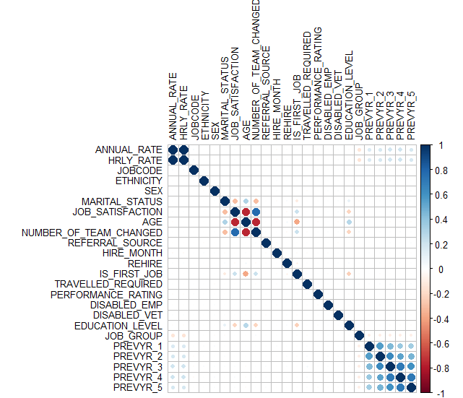
Correlations

Slide 8
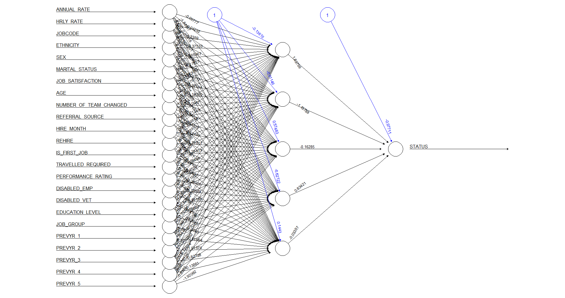
Artificial Neural Network (ANN)

Slide 9
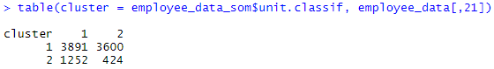
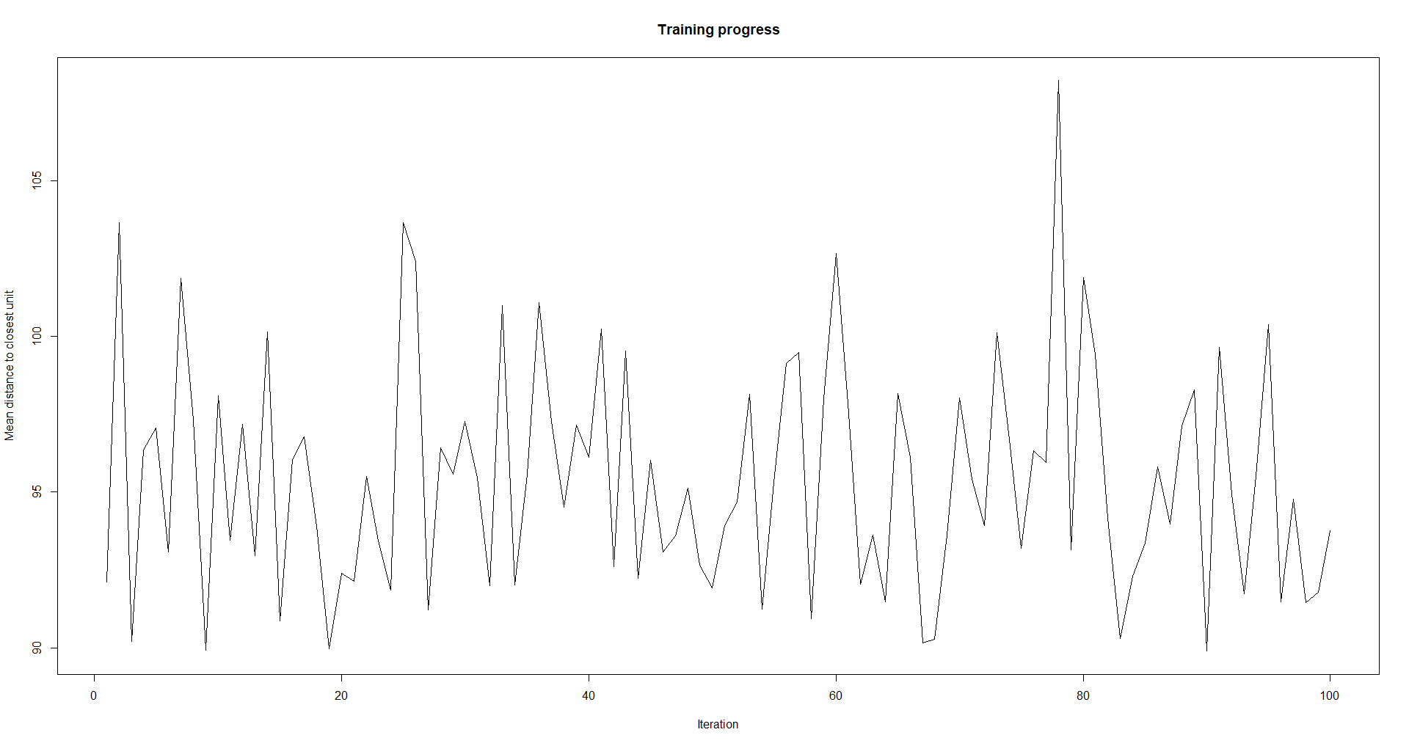
Kohonen

Slide 10
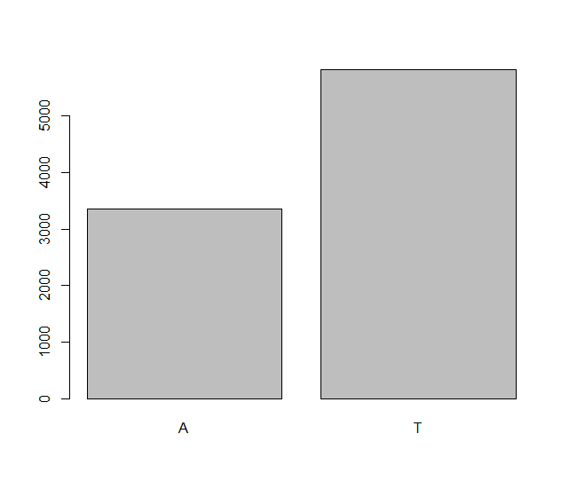
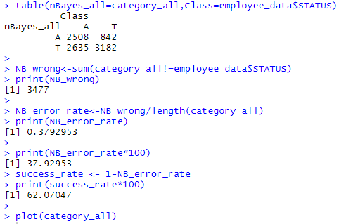
Naïve Bayes

Slide 11
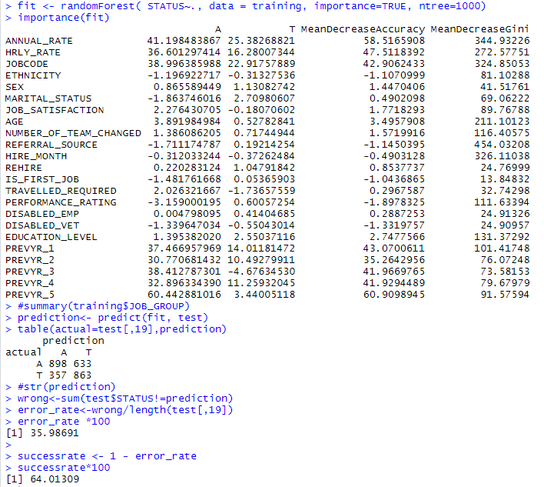
Random Forest

Slide 12
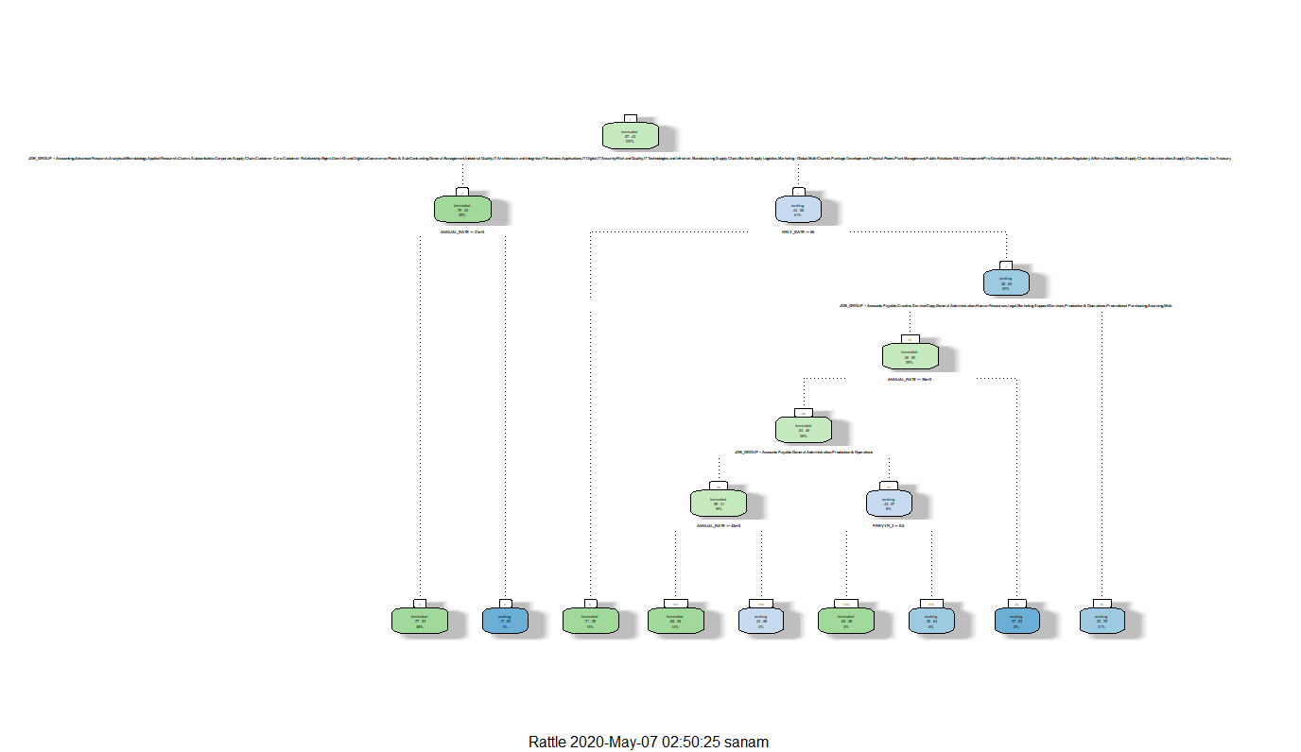
CART

Slide 13
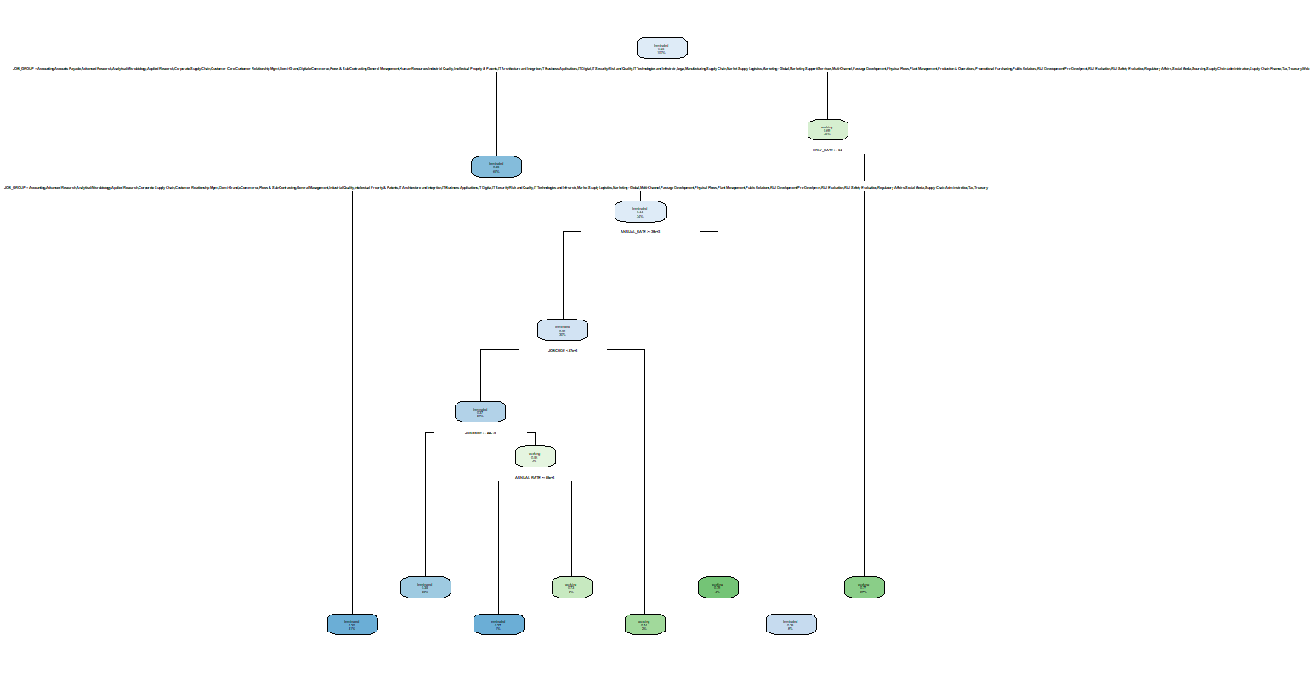
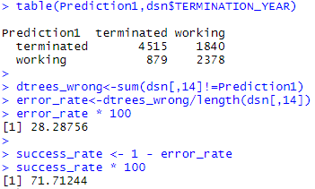
Decision Tree

Slide 14
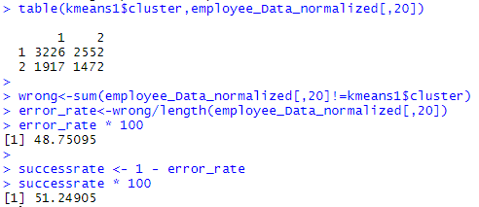
K-Means

Slide 15
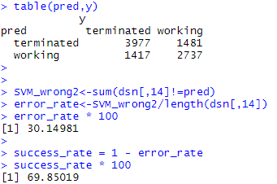
Support Vector Machine (SVM)

Slide 16
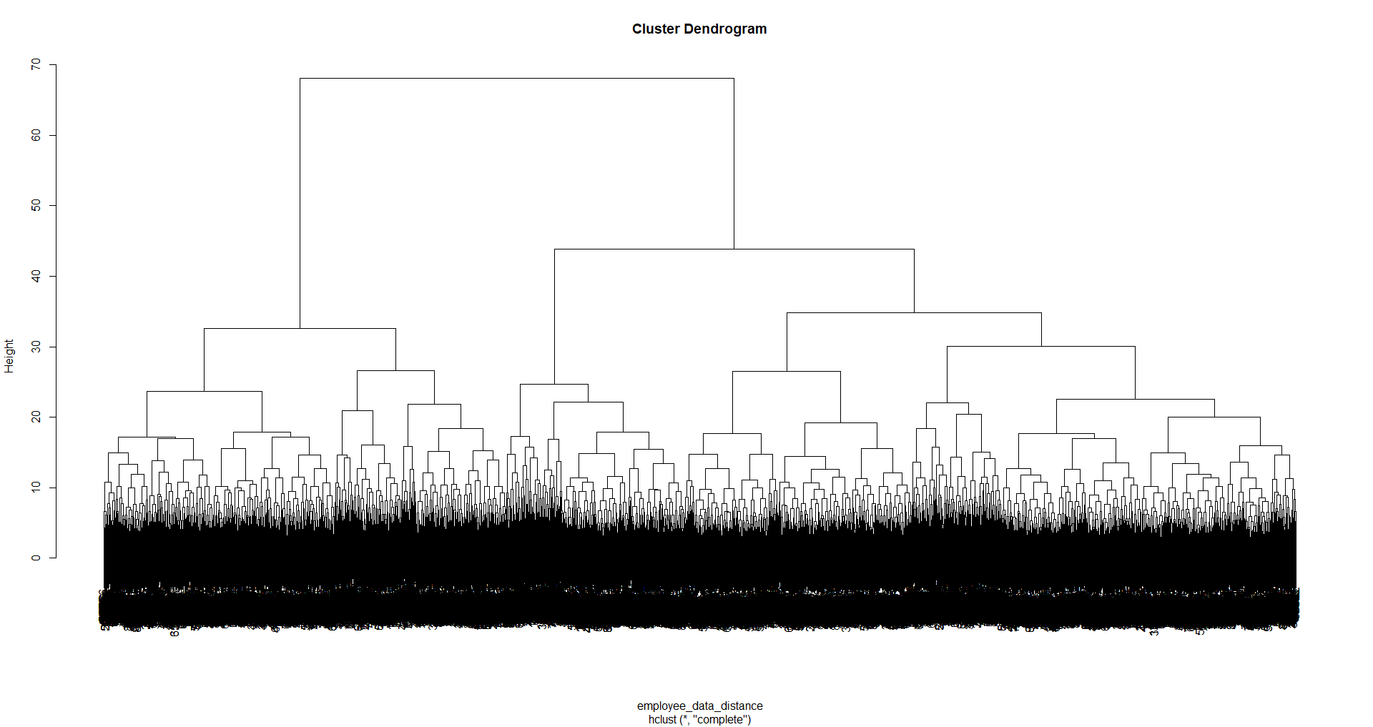
H-Clust

Slide 17
K-nearest neighbor (KNN)

Slide 18
Conclusions
By using the above methodology, we have the following observations:-

